Slide 1
OIT: Transition of I.T. Service Delivery
Progress and Goals Update
Dr. Joanne Hale
Secretary of Information Technology

Slide 2
OIT Mission Statement
Make State Business
Better, Faster, Safer, Cheaper

Slide 3
Today’s Agenda
Introductions
Transition Drivers
Timeline
OIT Organizational Structure
Area Goals and Initiatives
Operations
Security
Support Services
Q&A
Next Steps

Slide 4
Introductions
Dr. Joanne Hale
Secretary of Information Technology
Jim Purcell
Chief Operations Officer
Mason Tanaka
Chief Information Security Officer
Cheri Martin
Deputy Secretary of Information Technology

Slide 5
Transition Drivers
For Customers:
Customer Service
Transparency
Cybersecurity
For OIT Staff:
Stability of Leadership
Clarify Direction

Slide 6
Timeline
Executive Order 26
Interagency Agreement
Proposed Legislation
October 2017

Slide 7
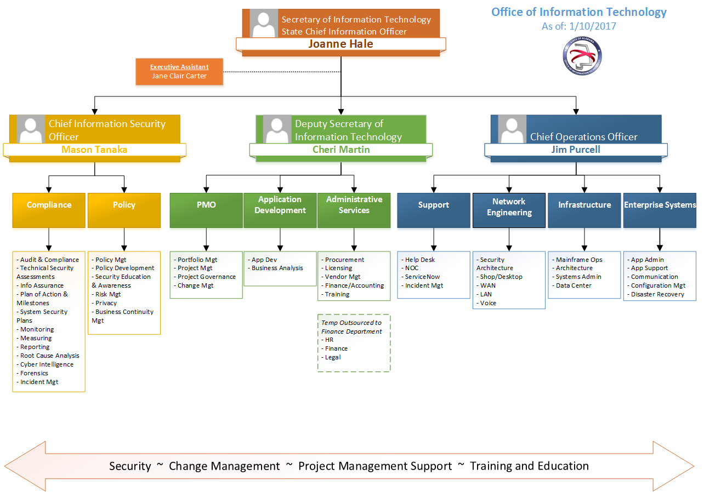
Organizational Structure

Slide 8
OIT Operations
Mr. Jim Purcell
Chief Operations Officer

Slide 9
OIT Operations
Background
CTO Brasfield & Gorrie since 1998
$3 Billion in revenue
180 jobsites in 19 states ~10 starts/stops per month
22nd largest construction company in US
Why applicable
Construction industry is excellent at the shared services and charge back world.
All costs have to make it out to the jobs and be recovered.
Cost accounting world
Transparency of cost is paramount
Thin operations on razor thin margins
Communications over various connections and conditions a way of life

Slide 10
Mission of Operations
Services organization
Provide fast, secure affordable IT services with transparent cost and no down-time.
Improve customer service
Service-Now, help desk training, 85% closed on contact goal, SLAs for resolution, transparency in performance
Not getting quick problem support will be addressed by reorganization and training
NOC operations merged with help desk for efficiency and consistency
Retirement of multiple ISD data centers
Cost savings and Resiliency
Cloud focus where it makes sense
Eye on the mission
Improve resiliency
Offer affordable services that agencies need to fulfill their mission.
Should the agency do this IT function
Can economies of scale or performance help
Can the state and the taxpayers benefit from a centralized service and delivery more efficiently for less money
Can we meet Federal match audit standards
We understand you have doubts, concerns but want to earn your business?

Slide 11
Major Projects That Support Our Mission
WAN Migration
Old Legacy BellSouth NetVPN MPLS Network
AT&T set to retire
We must transition to the new technology or you will not have connectivity across the state
We are in an extended support agreement and pushing to meet the go dark deadline
Similar to a Windows forced upgrade
Huge undertaking
Very far down the road
End result will be faster service and multiple carriers for redundancy
Enables voice (VOIP) and video success

Slide 12
Major Projects That Support Our Mission
WAN Migration
Data Center Consolidation
Data Center Facility Age
State House then Folsom
Flooding
Heat in the summer time
Older infrastructure of fire suppression and physical security
Moving to RSA Dexter
State of the art facility

Slide 13
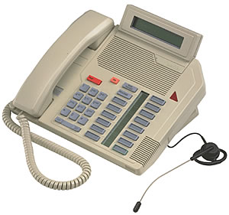
Major Projects That Support Our Mission
WAN Migration
Data Center Consolidation
VOIP
Going after the old beige phones first
We will work with you on a case by base, agency by agency basis
Understand your needs
Come up with a collaborative solution
It has to support the mission
DHR
65% rolled out ShoreTel
Has staff to support further roll out
Can come back later and add SIP trunking and centralized switching with existing handsets

Slide 14
Security and Policy
Mr. Mason Tanaka
Chief Information Security Officer

Slide 15
CISO Mission Statement
To develop, maintain, and promote an Enterprise Cybersecurity Program that establishes security goals, objectives, and requirements that minimize risk to information systems and data leading to an improved cybersecurity posture for the State of Alabama.

Slide 16
Enterprise Cybersecurity Program
Adoption of Federal Standards
National Institute of Standards and Technology (NIST)
Federal Risk and Authorization Management Program (FedRAMP)
Risk-Based Approach
Identify potential threats and vulnerabilities.
Implement the right security controls to mitigate those flaws.

Slide 17
Enterprise Cybersecurity Program (cont.)
Main Goals:
Confidentiality: Ensuring systems and data are protected from unauthorized access.
Integrity: Ensuring data is an accurate and unchanged representation of the original secure information.
Availability: Ensuring systems and data are readily accessible to the authorized user.
Develop and Promulgate Policies and Standards that support the Cybersecurity Program

Slide 18
OIT Agency Assistance
Improve Agency Cybersecurity Posture
Agency Specific Cybersecurity Plans, Programs, and Policies
Federal Compliance and Audit Support
Network and Systems Security Assessments
Utilize Existing Agency Federal Reporting Requirements
Foster a collaborative and mutually-beneficial relationship

Slide 19
OIT – Agency Relationship
Office of Information Technology
Enterprise Cybersecurity Program, Policies, Standards, Procedures, Guidelines, Templates
Develops & Promulgates
Assistance
Governs
Complies With
Feedback
Agencies, Departments
Agency Cybersecurity Program, Policies, Standards, Processes, Guidelines, Templates
Develops &
Maintains
Organizational
Program & Policy

Slide 20
Administration and Project Management
Ms. Cheri Martin
Deputy Secretary of Information Technology

Slide 21
To Minimize costs to provide IT services
To Streamline administrative processes
To Maximize resource availability
To ensure successful completion of IT Projects

Slide 22
Administrative Support
Procurement
Process Internal purchases needed to provide IT services
Establish and Manage Statewide IT Contracts
Review and Approve Agency IT purchases
Finance/Accounting
Manage Office Funds and Budget
Process Accounts Payables and Receivables**
Service Catalog/Billing
Define services and map costs
Personnel
Process internal personnel actions**
Establish statewide IT Training and Education plans
Asset Management
Inventory Software Licenses
Inventory Software Systems
Inventory IT Hardware
Inventory IT Staff
Get Best Value
Transparency
Strengthen Skills

Slide 23
IT Governance & Project Management
IT Governance
Monitor and oversight of significant IT projects
Conduct IT Project Audits
Project Management Services
Manage internal projects.
Manage Enterprise projects.
Provide PM support to agencies with Standards and Best Practices

Slide 24
Questions?

Slide 25
Next Steps
Legislation
Facilitate open communication
Quarterly updates

Slide 26
OIT Contact Information
Joanne Hale
(334) 242-7360
Cheri Martin
(334) 242-7339
Jim Purcell
(334) 242-3800
Mason Tanaka
(334) 242-3800

