Slide 1
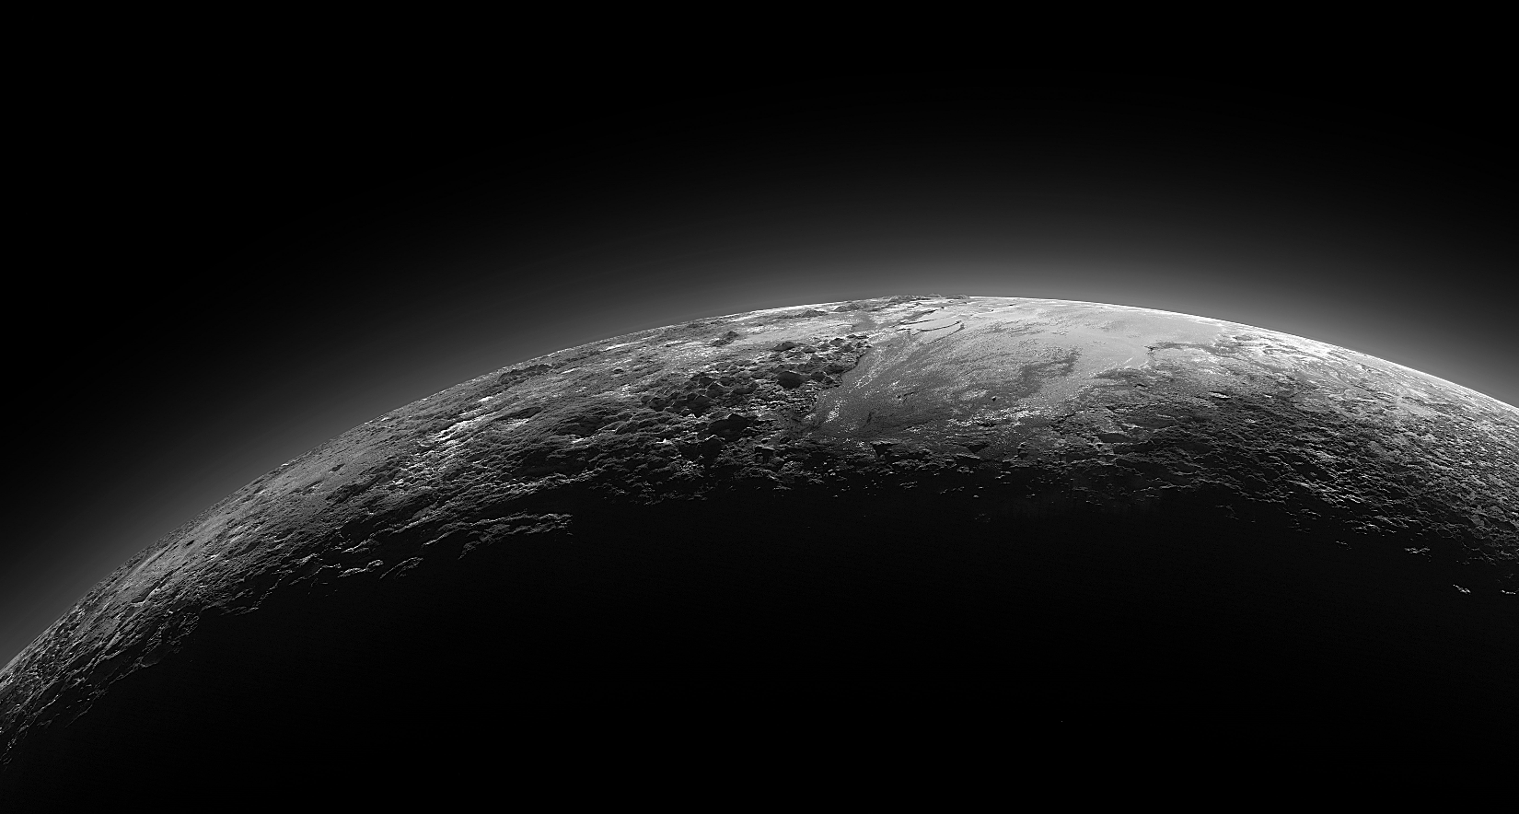
What Does a
CBA and Pluto
Share in Common?
Cost-Benefit Analysis (CBA): How to Appropriately Use this Investment Appraisal Tool and What It Can Tell Us About Value.
Notes:
IT Projects use scarce organizational resources and therefore care must be exercised in choosing projects that benefit the organization. A cost-benefit analysis (CBA) is an effective way to evaluate an IT project and quantify the relationships among the project’s inputs, outputs and purpose. It permits you to not only assess the long-term impact of proceeding with (or not proceeding with) a project, but enables you to directly compare different types of projects. The analytic focus of a CBA can range from a small agency project to an enterprise-wide project.
In this session, we will examine the CBA portion of the Project Initiation Tool - OIT Template 410T1.
We will discuss the methods and techniques used to justify a project’s expenses in relation to the value it creates for the organization.
We will discuss a variety of financial techniques necessary to quantify costs and benefits such as present-value, return-on-investment (ROI), cost/benefit ratio, and break-even.
We will address the complexity of monetizing intangible (soft) benefits as well as estimating costs that have varying degrees of probability. You will leave the session with a solid foundation for using the Project Initiation Tool to conduct a CBA as part of the overall Business Case for your IT projects.

Slide 2
Harvard science historian Owen Gingrich, who chairs the IAU planet definition committee, states…
"a planet is a culturally defined word that changes over time,"
and that Pluto is a planet.
Notes:
The International Astronomical Union (IAU) is a member of the International Council for Science (ICSU). Its main objective is to promote and safeguard the science of astronomy in all its aspects through international cooperation.
The International Astronomical Union (IAU) was founded in 1919. Its mission is to promote and safeguard the science of astronomy in all its aspects through international cooperation. Its individual members — structured in Divisions, Commissions, and Working groups — are professional astronomers from all over the world, at the Ph.D. level and beyond, and active in professional research and education in astronomy.

Slide 3
Another expert, Gareth Williams, associate director of the IAU's Minor Planet Center, says …
Pluto is not a planet, citing the official definition,
which states that a planet is a celestial body that:
• Is in orbit around the sun.
• Is round or nearly round.
• Is not surrounded by objects of similar size and characteristics.

Slide 4
Robert Britt, Senior Science writer for Space.com, posed a series of questions about the new definition of a “planet” and its merits and shortcomings to several astronomers,
… among them Geoff Marcy at the University of California, Berkeley.
Notes:
Robert Roy Britt (Senior Science writer for Space.com)
Shortly after the Prague vote on whether or not Pluto should be removed as a planet, Robert Britt posed a series of questions about the new definition of a “planet” and its merits and shortcomings to several astronomers, among them Geoff Marcy at the University of California, Berkeley.

Slide 5
“Your questions imply that a definition of the word 'planet' is useful scientifically. That is a view not shared by many professional planetary scientists. The astrophysics of planetary bodies is so rich and complex that defining 'planet' has never been an issue under discussion among professionals. So, some of your questions read to me like the old loaded question…
'When did you
stop beating your wife?'”
(Loaded question… Dr. Marcy has never been Married)
Notes:
Geoffrey William Marcy is an American astronomer. He is one of the pioneers and leaders in the discovery and characterization of planets around stars other than the Sun. Marcy was Professor of Astronomy at the University of California, Berkeley and an Adjunct Professor of Physics and Astronomy at San Francisco State University

Slide 6
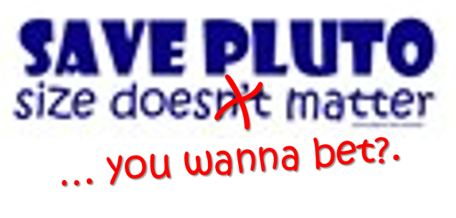
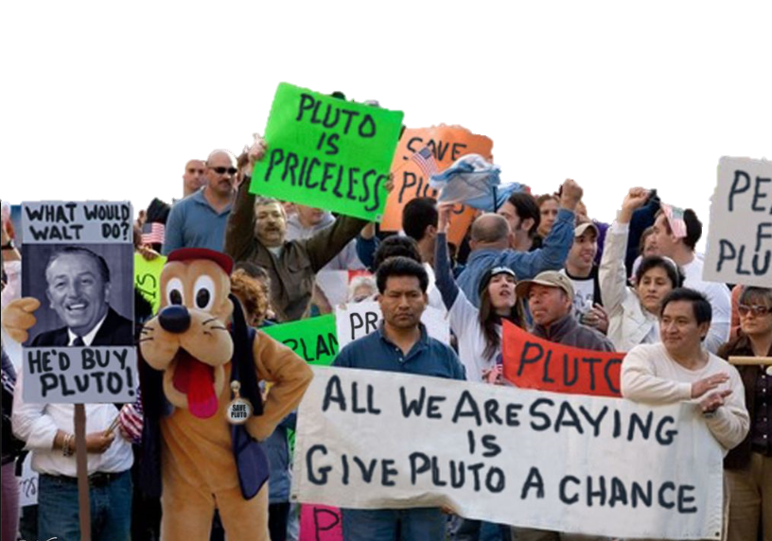
Notes:
Just as there are differing opinions on the definition of a planet, so it is with the terminology used in CBA.

Slide 7
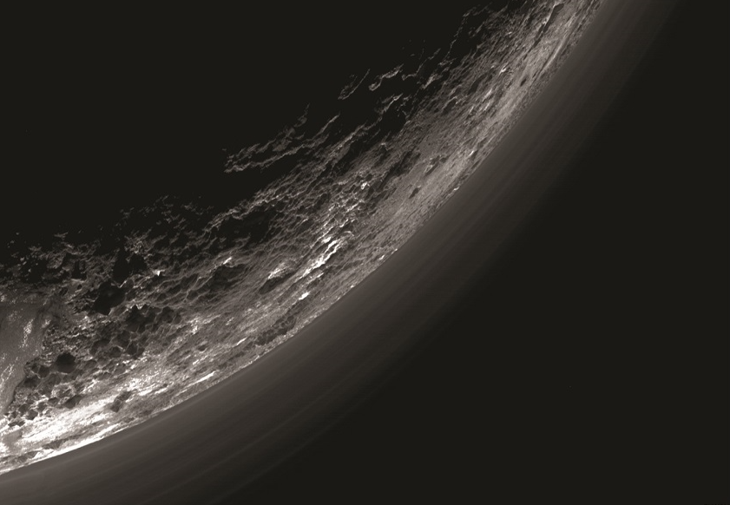
Definitions, semantics, and vernacular of a CBA are not near as crucial as is a fundamental understanding of the concepts.
Notes:
There are many definitions for the techniques and methods used in a CBA. Some have spured endless debate among financial analyst.
While accurate definitions of the various terms are important, it is more important that we have a consensus on the fundamental concepts.

Slide 8
Gathering the data to support a CBA may take considerable time. However, the utility depends as much on the analysis carried out on the data as it does on the figures themselves.
Notes:
Don’t think of the time just as being what is required to complete the analysis output.
Emerging from this process are opportunities to discover new insights about your organization, its programs and its internal processes.

Slide 9
A cost-benefit approach is a method for organizing thought rather than substituting for it.
Notes:
If all you are doing is filling in the blanks with just enough to data to get by, you are not preforming an analysis. You are simply shoving data into a template.
The CBA portion of the Project Initiation Tool is there to aid you in organizing your thoughts in a beneficial manner.

Slide 10
Objectives
Develop general consensus on CBA and terminology
Understand to what extent we use a CBA for our IT projects
Discuss methods for monetizing costs and benefits
Discuss methods for monetizing soft (Intangible) benefits
Notes:
Objectives for today’s session.

Slide 11
Consensus on Some Common Terms
Notes:
Let’s begin with establishing some consensus on some of the more common terms we will see during this presentation.

Slide 12
CBA is both a theory and a practice or a practice that is an applied theory.
From a theoretical perspective, CBA is ideas, principles, and techniques that are applied to a subject, especially when the results of the CBA are seen as distinct from investment decisions.
Notes:
Different individuals think of a CBA differently.
It depends on your particular perspective.

Slide 13
CBA is both a theory and a practice or a practice that is an applied theory.
From a theoretical perspective, CBA is ideas, principles, and techniques that are applied to a subject, especially when the results of the CBA are seen as distinct from investment decisions.
For an economist, CBA is a mathematical tool used in decision making for determining if the perceived benefits outweigh the expected costs and for extending that determination to the social welfare of a community.

Slide 14
COST-BENEFIT ANALYSIS
Analysis... (understanding and explaining is as important as measuring and calculating)
...of the flows (inputs and outputs) (Activities undertaken and Results that emerge)
…in terms of costs and benefits... (carefully distinguishing between those flows which are costs and those which are benefits)
...which are valued... (defined in monetary units of measurement)
...and are then compared and combined... (Using mathematical methods to provide synthetic information and estimates of the project's return on investment.
Notes:
For the purpose of today’s presentation, lets describe a CBA this way.

Slide 15
Costs and Benefits
Types of Costs:
Non-Recurring: Defined, one-time costs to the project.
Recurring: Costs to the project that are incurred periodically or over a set period of time.
Notes:
For our purposes, we will look at Costs as being in two categories.

Slide 16
Costs and Benefits
Types of Benefits:
Quantitative: e.g., reduced need for clerical staff and file storage, improved staffing utilization, increased collections.
Qualitative: e.g., improved benefits integration, improved response times to reports, automated forms generation, better decision making.
Notes:
We will define Benefits as being one of two types.

Slide 17
Present Value Discounting (PV)
Equalizes comparison of alternatives when expenses and benefits are distributed unequally over time
Typically use CPI as present value factor. 3% - 5% is a typical range absent required Internal Rate of Return (IRR).
Typically Present Value Discounting is NOT required once the State has selected its alternative.
Notes:
Present Value (PV)
Just think of it as how time affects the value of money.
One dollar today is worth more than one dollar five years from now.
Once you have compared two alternatives based on PV and selected one for implementation, you no longer need to discount. You focus on the actual value of the dollar in the time period its inflow or outflow.

Slide 18
Present Value (PV)
The present worth of future sums of money. PV is calculated by discounting the future sum using a discount rate.
The Discount Rate takes into account the Time Value of Money, e.g., Inflation. It may be based on the organizations Cost of Capital, which takes into account the amount of acceptable risk of capital and required rate of return for investments.
At the current time, the OIT CBA uses a simple inflation projections as the discount factor (CPI = .021 or 2.1%).
Cash Flow
$100
$100
Present Value =
=
=
=
$93.55
(1 + Discount Rate)^{n}
(1 + .021)³
1.064
Notes:
This is how PV is calculated.

Slide 19
Net Present Value (NPV)
The difference between the present value of Benefits and the present value of cash Costs after they are discounted by a specified rate of return.
NPV > 0 is acceptable.
Future inflows (Benefits) are discounted to derive Present Value (PV)
NPV =
Present Value of Cash Inflows
- Present Value of Cash Outflows
Notes:
Net Present Value (NPV) is bottom line balance represents a gain.

Slide 20
Benefit Analysis: Types
You need to identify and characterize all benefits.
Increased collections/revenue
Program cost savings
System cost savings
Program cost avoidance
System cost avoidance
Qualitative (Soft Benefits Monetized)
Notes:
When considering benefits, you need to consider everything, including the soft benefits.
This is also true for costs.

Slide 21
Caution
Time “Savings”
Time savings through productivity improvements alone is not a viable benefit.
Consider in your analysis what useful purpose was that time savings directed toward.
Notes:
If you save time and do not apply that time to generate benefit elsewhere, there is no gain.

Slide 22
Caution
Avoid common errors such as:
Double Counting
Counting Sunk Costs
Omitting Costs
Productivity Improvements Alone
Notes:
It is easy to overlook these types of mistakes.
If your proposed solution results in one less FTE which you record in the category of “Labor Reduction”, you can’t count it again in another category such as “Cost Reduction” or “Efficiency Improvement”.
If you reduce your need for two contracted personnel, you can’t include the cost of the office space they occupied. You are paying for the same amount of office space regardless of whether they are empty or not.
It is easy to overlook costs associated such as downtime, training, loss of productivity during transition, etc.
Like time, an increase in productivity must be reapplied to produce an increase in benefit.

Slide 23
Quick Example of CBA
Proposed Solution
for
Increasing Child Support Collections of Foster Care Children
Notes:
Let’s walk through a CBA example focused on just hard (tangible) benefits.

Slide 24
Baseline: Based on a current population of 1000
75% of foster care population could be referred to child support.
Currently, only 20% of eligible cases are referred.
We know that 20% of all cases referred are collected.
The average collected payment is $76.40 per month.
Notes:
This is our status quo or current solution.
It is the baseline we will use in contrasting an alternative.

Slide 25
Measurement Plan:
Actual collections will be measured.
Estimate 75% of Year 3 population of 1000 could still be referred to child support.
The proposed solution will result in 100% referral rate.
The same 20% collected with an average payment of $76.40 per month.
Notes:
This is what we anticipate in the proposed alternative.

Slide 26
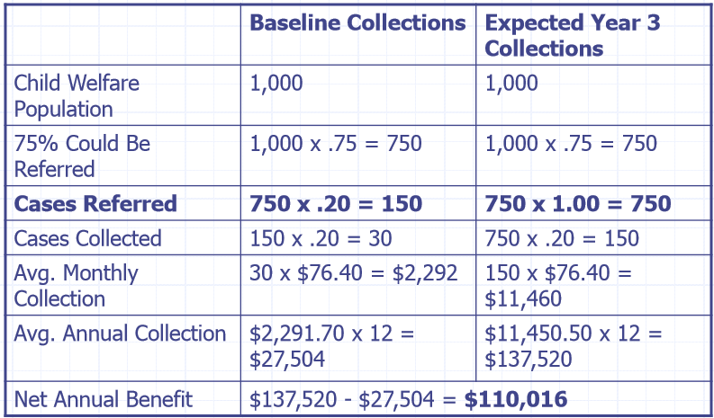
Comparison of Baseline to Proposed
Current Solution (Baseline)
Proposed Solution (Estimate)
Notes:
We contrast the baseline with the alternative.

Slide 27
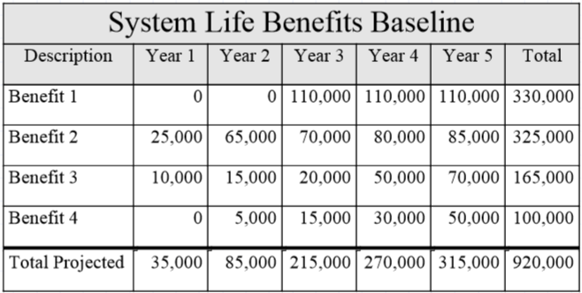
Project Values for Each Period of Time
Notes:
We project the estimates for each benefit over time.

Slide 28
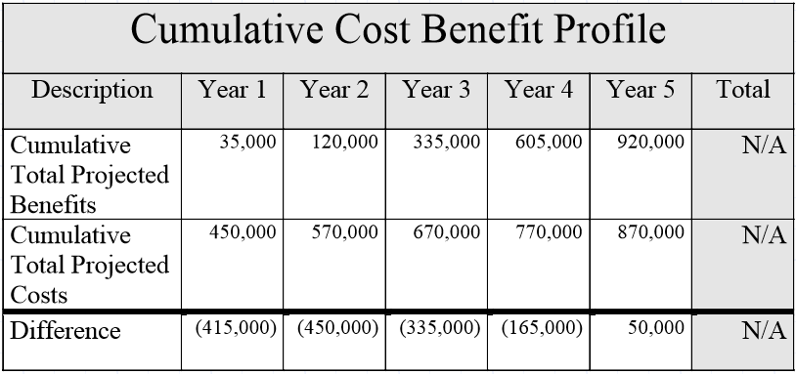
Projected Breakeven in Year 5
Notes:
We produce a cumulative profile of costs and benefits over time.
The time in which the cumulative benefits exceed the cumulative costs is breakeven point.
It is where benefits gained have surpassed the costs.

Slide 29
Must be able to describe and defend
Suggest creating a narrative description of costs and benefits, including how they were derived
There are no automatic disapprovals for cost benefit analyses that fail to breakeven.
If the analysis will not breakeven, you may be asked to prove that the measurable outcomes are worth the cost of investment, and that those costs are reasonable.
Notes:
Be sure that you can justify your cost/benefit values.
You must be able to defend your assessment.
Not all projects will breakeven. Health and safety projects can fail to breakeven and must be justified.

Slide 30
Monetizing Soft Benefits
The boundary between these types of benefit is not always clear and depends on the judgement of the analyst.
Sometimes, "experimental" evaluations, involving partial methods for valuing benefits, may be used.
You, as the subject matter expert, are familiar with the micro effects of your process. Your judgment, historical knowledge, and expertise will likely be the best tools for identifying value.
Based on these tools, you construct a defendable rationale.
Notes:
Monetizing soft benefits requires professional or expert judgement.
The methods used should be based on the best data available at the time.
When no data exists, you may be required to derive data in an experimental fashion.
As a SME, you know what data makes the most sense. You use you knowledge and expertise to make you business case.

Slide 31
Quantify Intangible (Soft) Benefit
Example: Improved Customer Goodwill
Monetary Value = ???
Notes:
Lets walk through an example. of monetizing a soft benefit

Slide 32
Without tangible facts and figures, you must make supported estimates based on your knowledge, experience, expertise, and any research data available to communicate the most realistic and accurate business case possible.
Please keep in mind: Even hard Costs/Benefits estimates based on tangible facts are still estimates for a yet-to-be determined future.
Both hard and soft benefit estimates are based on the same thing:
An acceptable and trusted rationale
Notes:
The key is this – whether it is a tangible or intangible benefit, they are still estimates.
Estimates of the future are often inaccurate due to faulty data or data that becomes less accurate as time progresses.
Your estimates must be based on a rationale that others can accept as trustworthy.
Its possible that the validity of a benefit estimate rests solely on your expert judgement.

Slide 33
Fictitious Example
You are nearing your 7th year as Director of the only Highly Fictitious Business Card Printing Division for the State of Alabama. Your division specializes in the design and printing of business cards for agencies, colleges/universities, and other state government related entities. Your entire operating budget is funded by the fees collected from state entities that request business cards for their employees.
Annual revenue generated by the division has remained steady at $150,000 for the past seven years, with just enough year-over-year revenue growth to fund the budget and keep up with rising material and equipment maintenance costs.
Notes:
Lets create a fictitious scenario where you are tasked with deriving the value of a soft benefit.

Slide 34
Fictitious Example
Over the past three years, you’ve researched various emerging technology trends that have the potential for luring away some long-time customers.
While some technologies are impressive, they offer no significant advantage over traditional business cards. They are both equal in meeting the customers needs.

Slide 35
Fictitious Example
Based on your budget analysis, you are very aware that losing customers would create a funding shortfall that could not be recovered.
Based on recent customer surveys, you are also aware that without some compelling reason to change, your customers are content with using business cards.

Slide 36
Fictitious Example
During a recent meeting, you received feedback from customers about it taking so long to complete an order online, oftentimes getting timed out resulting in reentry of data.
You explained that the problem was because of an old database server that had very few resources for processing the volume of requests.

Slide 37
Fictitious Example
You further explained that you reviewed the cost/benefit analysis performed by your management staff which concluded the department wouldn’t gain enough in added benefit to justify the cost ($45,000) of replacing it.

Slide 38
Fictitious Example
Your customers responded by saying that it would certainly be of tremendous benefit to them.
You agreed but added that the overall cost cannot be justified.

Slide 39
Your previous analysis to justify the cost of upgrading the database server fell just below the line to produce a positive return on the investment.
Based on your spending plan, proceeding with the upgrade would mean that you wouldn’t be able to make another planned investment that does promise a positive return.
Investment: Automatic Card Sorter 8000e®
Life of Solution: 10 Years
Costs: $30,000 Purchase + $2,000 per year Maintenance x 10 yrs. = $50,000
Benefit: Reduction of labor required to manually sort cards
Benefit Value: Hr. Rate x Number of Hours per Month = $500

Slide 40
Cost of Card Sorter: $45,000
Life of Solution: 10 years
Automatic Card Sorter 8000e®
$50,000 (Cost)
100 Months
(8 years 4 mos.)
Payback Period =
=
$500 (Monthly Benefit)
$1.20 in Benefit
= for each $1.00
invested
Benefit Cost Ratio (BCR)
$60,000 (Benefits) ^{10 Years}
=
$50,000 (Costs)
Looks like a fairly solid project.

Slide 41
But What About the Database Server?
Improved Customer Goodwill
How Do You Monetize
a Soft Benefit Value?

Slide 42
Without tangible facts and figures, you must make supported estimates based on your knowledge, experience, expertise, and the data available to communicate the most realistic and accurate business case possible.
Leverage the expertise of others in your division.
Review historical data if applicable.
Solicit feedback from stakeholders.
Conduct a survey of constituents.
Gather insights from similar research or case studies.
Use what is available to you and apply your professional judgement.
Notes:
Deriving a value of a soft benefit does not have to be completed in a vacuum.
If you are lacking in some insight, there are other ways to obtain it.
One suggestion is start with the key stakeholders… the ones initiating the project.

Slide 43
If you apply all the knowledge, expertise and data available and your analysis is refuted by someone…
There is a good chance that person will have less knowledge, expertise and data than you.
Notes:
If you are confident that you’ve tapped all the available sources, you can probably successfully defend your assessment.
If someone presents data contrary to your findings, you should be grateful for them finding something that you could not.
You should include it in your reassessment.

Slide 44
What Do We Have to Work With?
Insight
You’ve spent 3 years researching technology trends
Knowledge
You’ve gathered feedback from your customers
Experience
You are a 7-year veteran of the Division
There is a good chance that most people will have to defer to your judgement when it pertains to soft benefit estimates in the business card industry.
Insight
You’ve done a budget analysis
Knowledge
You have all the revenue figures
Expertise
Your Division specializes in this industry
Insight
Your customers have told you of their needs
Knowledge
You’ve done customer surveys
Notes:
If you’ve done a thorough analysis, your estimates will most likely be accepted as trustworthy.

Slide 45
Another option is to just guess and hope no one questions you.
Notes:
Unfortunately, sometimes this is the case.

Slide 46
One Technique for Our Example
Using your knowledge and expertise, or knowledge and expertise leveraged from other sources as supporting evidence…
… you estimate the most likely future result and remain open to making adjustments should new evidence be made known to you.
Notes:
Lets look at one technique.

Slide 47
. First: Examine all of the potential impact scenarios.
Second: Access the probability of each scenario and derive the . . most likely future result.
Notes:
Here you are using your expertise to examine all possibilities.

Slide 48
Rather than asking
“What can I gain from Improved Customer Goodwill”?
Reverse the Question
Question: What is the result of customer “ill” will (or doing nothing
to improve customer goodwill)?
Answer: The customer will submit fewer (or no) orders.
Question: To what degree will an average customer reduce orders?
Answer: You know your business better than anyone. Use your . knowledge and expertise to make an informed prediction of. . the most probable scenario.
Notes:
Sometimes we turn the unanswerable question around or ask it a different way.
If you can’t determine what something is worth if you had it, figure out what it would cost if you didn’t have it.
The idea is to establish a true value of something.

Slide 49
Based on what you know as a 7 year veteran of the Business Card industry and knowing what you know about your current customers, what is your opinion on the likelihood of the average customer…
Trying out one of the new technologies for a few of their employees, thereby, reducing their business card orders by 10% or less?
What do you think is a realistic probability of that type of reaction from the average customer?
Experiencing enough “ill” will to send you a strong message of their dissatisfaction by converting 50% of their employees?
Experiencing enough “ill” will to only use you as a last resort, resulting in a loss of 90% of orders?
Dropping you altogether, resulting in a loss of 100% of orders?
Notes:
In this example, we have 4 scenarios
A customer reducing orders by 10%, 50%, 90%, and 100%
Your unique situation may call for more or less scenarios.

Slide 50
Establish Some Justification for the Estimate
Percentage of Orders Reduced |  | Probability of Occurring |  | Weighted Value Percent of Orders Reduced
10% | X | 50% | = | 5%
50% | X | 20% | = | 10%
90% | X | 10% | = | 9%
100% | X | 5% | = | 5%
 |  |  |  | 29%
Highest Probability – Least Impact
Lowest Probability – Greatest Impact
Best Estimate
Close to 1/3 of Annual Revenue is Tied to the Benefit of Improved Customer Goodwill
Notes:
You examine each scenario and determine a probability of occurrence.
This is your best estimate based on the data (knowledge, experience, expertise) that you have. Absent for any additional data, it is all you have.
The “value” of Improved Customer Goodwill is worth, in your expert opinion, almost 1/3rd of your annual revenue.

Slide 51
Remember this…
“Your previous analysis to justify the cost of upgrading the database server fell just below the line to produce a positive return on the investment.”
Lets take another look.
Notes:
Based on your prior analysis based on just the “hard” benefits, the cost slightly outweighed benefits. It was close, but not quite close enough to justify the project.
What if we added in the value of the soft benefits? Could it add enough in benefit to justify the investment?

Slide 52
Estimate the Future Value of a Soft Benefit
Improving Customer Goodwill
Annual Revenue: $150,000
Potential Loss of Revenue for Doing Nothing: 29%
$150,000 x .29 = $43,500
$43,500
=
$3,625 per month
12
Notes:
Our value is + $3,625 per month.
You could use annual figures. You just need to be sure to apply it the same all the way through.

Slide 53
Estimate the Future Value of a Soft Benefit
Improving Customer Goodwill
Improving Customer Goodwill Actually Does Have a Monetary Value
It is worth $43,500 Annually to your program
Notes:
We derived a “value”.
We are not considering this as a cash inflow, as that would make it a hard benefit.
Our task was not to convert Goodwill into a revenue stream, rather it was to determine what Goodwill was worth and convert that into a monetary value.
Another way of looking at this is by asking…
“How much would you be willing to pay for Improved Customer Goodwill or how much would you say its worth to you”?
- “I’d say that I would be willing to pay about $40,000 to have it”.
“How did you derive that particular value”?
- “Its just based on a gut instinct”.
Both methods came to the same conclusion; Improved Customer Goodwill is of some value.
The probability exercise we just completed is way of justifying that value to someone else in a way they can understand.
Asking them to accept a gut instinct is just asking them to blindly accept something they have no way of understanding.

Slide 54
Cost of Database Server: $45,000
Life of Solution: 6 years
$45,000 (Cost)
=
12.4 Months
(1 year 3 mos.)
Payback Period =
$3,625 (Monthly Benefit)
Benefit Cost Ratio (BCR)
$261,000 (Benefits) ^{6 Years}
$5.80 in Benefit
= for each $1.00
invested
=
$45,000 (Costs)
Notes:
With Soft Benefits included, our project looks a lot more favorable.

Slide 55
Cost of Database Server: $45,000
Life of Solution: 6 years
$45,000 (Cost)
=
12.4 Months
(1 year 3 mos.)
Payback Period =
$3,625 (Monthly Benefit)
Benefit Cost Ratio (BCR)
$261,000 (Benefits) ^{6 Years}
$5.80 in Benefit
= for each $1.00
invested
=
$45,000 (Costs)
Cost of Card Sorter: $45,000
Life of Solution: 10 years
$50,000 (Cost)
100 Months
(8 years 4 mos.)
Payback Period =
=
$500 (Monthly Benefit)
$1.20 in Benefit
= for each $1.00
invested
Benefit Cost Ratio (BCR)
$60,000 (Benefits) ^{10 Years}
=
$50,000 (Costs)
Notes:
Compared to the alternative project, its clear which investment promises the greater value.

Slide 56
Which is the better choice?
Notes:
At the end of the day, these are still estimates.
Our challenge is to provide the best support we can for the estimates.
In making our case (our business case) we are attempting to communicate to others what we believe is the best option.
Some may disagree on our assessment.
We, therefore, must communicate using well-thought out analysis and justification if we hope to change their minds.

Slide 57
Questions?

